Slide 1
Requirements and Architecture
© Len Bass, Paul Clements, Rick Kazman, distributed under Creative Commons Attribution License

Slide 2
System Requirement Categories
Functional requirements - what the system must do, how it must react to run-time stimuli
Non-functional - these requirements qualify functional requirements
  Quality attributes (the “abilities”)
  Business
  Architectural
Constraints - design decisions with zero degrees of freedom; i.e., a design decision that has already been made for you.

Slide 3
Quality Attribute(QA) Considerations
“A QA is a measureable or testable property of a system that is used to indicate how well the system satisfies the needs of its stakeholders.” (SAiP p.63)
If a functional requirement is "when the user decides to change runtime preferences a change preferences dialog shall appear”:
  a performance QA might describe how quickly the dialog will appear;
  an availability QA might describe how often this function will fail, and how quickly it will be repaired;
  a usability QA might describe how easy it is to learn this function.
Functionality determines software architecture
true or false?

Slide 4
Functionality and Architecture
QA’s
Functions
Functionality alone does not determine architecture
  Given a set of required functionality, there is no end to the architectures you could create to satisfy that functionality
  So functional design doesn’t matter?
Functionality and quality attributes are orthogonal
  Many ways to implement functionality with varying degrees of quality

Slide 5
Architecturally Significant Requirements
Architecture designs build systems that satisfy requirements
- But they must look toward current and future needs (known and unknown)
An architecturally significant requirement (ASR) is a requirement that will have a profound effect on the architecture
  Significant = high cost of change
How do we find those?
  In requirements documents, right?
NOTE: ASRs are predominately but not exclusively comprised of quality attributes. Quality is a multi-faceted measure!!
ASR Examples?

Slide 6
Why is this hard?
High-quality requirements documents may not exist
Emphasis on functionality not quality attributes
Design Quality attributes (ASRs), are high level.
  “The system shall be modular”
  “The system shall be easy to use”
  “The system shall meet users’ performance expectations”
Requirements documents do not include everything useful to the architect
  ASRs often derive from business goals
  Development environment
An architect can’t wait for “finished” requirements
  Proactively interview stakeholders but also ….
  Suggest relevant ASR’s for discussion

Slide 7
Collaborative Model
Interplay between requirements and architecture
Tradeoffs between system problem and solutions
  Challenges the tradition of avoiding solution thinking while discovering requirements
ASRs may only be recognized after some architecture design
Architecture feedback may eliminate infeasible requirements or poor cost/value benefits
Requirements
Architecture
Design

Slide 8
Characteristics of ASRs
Hard to define and articulate - general and abstract concepts users don’t understand
Needed early in the life cycle before needs are fully understood
Vaguely described, subjective; e.g., 24/7
Tend to be neglected initially – significance not appreciated
  Embedded in the expression of other requirements
Variable – subject to requirements and technology change
Situational – significance may depend on system context; e.g., scale, legacy systems, technology

Slide 9
Recognizing ASRs
Wide system impact
May involve resolving requirements tradeoffs
Strict (constraining, limiting, nonnegotiable) requirements that dictate a design
May invalidate conventional design tactic decisions
Difficult to achieve technically

Slide 10
Architecture: Quality Attributes
Developmental categories
  Modifiability
  Variability
  Supportability
  Testability
  Maintainability
  Portability
  Localizability
  Development distributability
  Buildability
  Portability
Operational categories
  Availability
  Interoperability
  Reliability
  Usability
  Performance
  Deployability
  Scalability
  Monitorability
  Mobility
  Compatibility
  Security
  Safety

Slide 11
F and N-F and QA => ASRs
Functional | Non-Functional
Display a list of all products available to purchase Organize lists by product category Display name, picture, description, price Catalogue wide search Shopping basket Support all major credit cards Validate payment through cc agency | Support at least 1000 transactions per day Handle peaks of 10 transactions/ second Allow 5000 concurrent users 24/7 Availability Data loss rate of 0% Order completion to payment confirmation within 5 seconds (95% of the time) Login complete within 5 seconds
Discussion: What ASRs come from which requirements? Which are ASRs? Which are not?
Notes:
ASR: Support all major credit cards; Validate through cc agency
Non-ASR: 1000 transactions/ day; 10/ second; 95% completion within 5 secs (but maybe if cc: agency is slow??); Login w/i 5 secs
ASR: 5000 concurrent users; 24/7; 0% loss;

Slide 12
Business Goals May Drive ASRs
Market share, competition
Product lines
Global markets
Revenue
Cost to develop, deploy, operate, and maintain
Personnel objectives
Liability, safety, reputation
Standards and regulations
Intellectual property
Environmental and sustainability concerns

Slide 13
Business Qualities (System QAs)
Time to market (buy or reuse)
Cost and benefit (tradeoffs)
Projected lifetime (modifiability, scalability, portability)
Target market (product line strategy, reliability, performance, usability)
Rollout schedule (scope and scale, deployment flexibility)
Integration with legacy and external systems (interfaces, constraints, interoperability)
Constraints (safety, security, modifiability, …)
Regulatory requirements

Slide 14
Architectural Qualities
Conceptual integrity – consistency, do similar things in similar ways
Correctness and completeness
Traceability – Can you trace back from your architecture decision to the original requirement?
  e.g. The architecture requires a FIPS-140 certified encryption algorithm to be accepted by the Pentagon as a customer
  e.g. The architecture requires all forms received to be processed in background without user intervention to satisfy 24/7 operational requirements
  e.g. The architecture requires user pages to be translatable to Simplified Chinese and satisfy all Section-508 accessibility requirements (Client usability spec)
  e.g. The architecture must allow backups of full data-sets within 1 hour to meet downtime constraints

Slide 15
Traceability Matrix example
ASR | Original req. | Source
FIPs libraries | FIPS-140 certified encryption algorithm to be accepted by the Pentagon as a customer | Business Goals
508-Compliance | … Will be sold in China mainland and satisfy all Section-508 accessibility requirements | Marketing goals
Simplified Chinese translation and character sets | … Will be sold in China mainland and satisfy all Section-508 accessibility requirements | Marketing goals

Slide 16
Scenarios and Stories
Scenario – A longer narrative of user and system interactions to accomplish a goal
User story – “short, simple description of a feature told from the perspective of the person who desires the new capability”
  One or two sentences
  Possible template…
  As a <user role>, I want <some goal> so that <some reason>.
Natural, easy to create, understandable but may be incomplete and ambiguous

Slide 17
Use Cases
Interaction between a user and a system
A complete and meaningful use
Focus on value – how the system will be used to satisfy a specific user goal
Observable and testable functionality - “black box” view of the system
The first system functional decomposition
All use cases = {all things the system must do}
Understand the big picture

Slide 18
Use Case Descriptions
For each use case describe functional steps in sufficient detail to …
  Enable (or represent) requirement specification
  Begin early design work
  Achieve stakeholder and user understanding and approval
The details …
  Name and description
  Actors
  Primary flow of events (as related stories)
  Secondary alternative and/or exception flow of events
  System preconditions
  System post conditions
  Supplemental information – non-functional requirements

Slide 19
“Why Use Cases at All?”
A good compromise – use cases are semi-formal, structured, but understandable stories (people like stories)
Use cases add value to analysis
  At first as a succinct outline of mainline features and capabilities (get your head around the functionality)
  Later a basis for innovation, extension, revision of requirements
Address exceptions – a large source of system complexity
Start functional decomposition that transitions to requirement specifications and early design
Good basis for pursuing related project information – estimates, plans, user interface design, software design, testing

Slide 20
ATM Model: Withdraw Cash Use Case
1 Brief Description
  This use case describes how the Bank Customer uses the ATM to withdraw money his/her bank account.
2 Actors
  2.1 Bank Customer
  2.2 Bank
3 Preconditions
  There is an active network connection to the Bank.
  The ATM has cash available.
4 Basic Flow of Events
  1. The use case begins when Bank Customer inserts their Bank Card.
  2. Use Case: Validate User is performed.
  3. The ATM displays the different alternatives that are available on this unit. [See Supporting Requirement SR-xxx for list of alternatives]. In this case the Bank Customer always selects “Withdraw Cash”.
  4. The ATM prompts for an account. See Supporting Requirement SR-yyy for account types that shall be supported.
  5. The Bank Customer selects an account.
  6. The ATM prompts for an amount.
  7. The Bank Customer enters an amount.
  8. Card ID, PIN, amount and account is sent to Bank as a transaction. The Bank Consortium replies with a go/no go reply telling if the transaction is ok.
  9. Then money is dispensed
  10. The Bank Card is returned.
  11. The receipt is printed
  12. The use case ends successfully

Slide 21
ATM Model: Withdraw Cash Use Case (2)
5 Alternative Flows
5.1 Invalid User
  If in step 2 of the basic flow Bank Customer the use case: Validate User does not complete successfully, then
  1. the use case ends with a failure condition
5.2 Wrong account
  If in step 8 of the basic flow the account selected by the Bank Customer is not associated with this bank card, then
  1. Tthe ATM shall display the message “Invalid Account – please try again”
  The use case resumes at step 4
.
.
.
7 Post-conditions
  7.1 Successful Completion
  The user has received their cash and the internal logs have been updated.
  7.2 Failure Condition
  The logs have been updated accordingly.

Slide 22
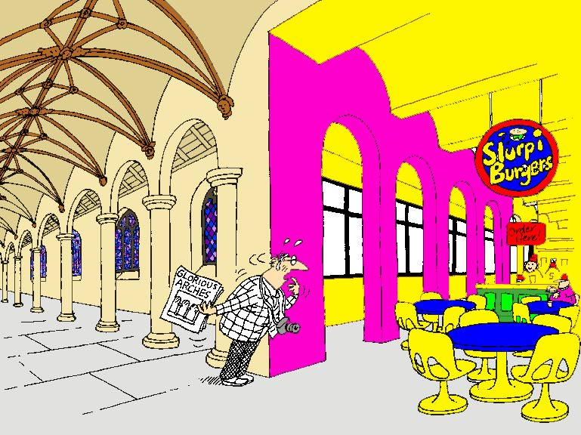
Conceptual Integrity

